Slide 1
Denial of Service Attacks
(DoS Attacks)

Slide 2
What are DoS attack
DOS is an attack used to deny legitimate users access to a resource such as accessing a website, network, emails, etc. or making it extremely slow. DoS is the acronym for Denial of Service. This type of attack is usually implemented by hitting the target resource such as a web server with too many requests at the same time. This results in the server failing to respond to all the requests.
Denial of Service attacks are designed to overwhelm a machine or server with excessive requests, with the ultimate goal of slowing down or taking down the server. In attempting to handle the hundreds (sometimes thousands) of excess requests, the server can’t handle legitimate user requests.
DoS = Denial of Service(when a single host attacks)
DDoS = Distributed Denial of Service(when multiple host attacks simultaneously)

Slide 3
History of DoS attacks
The first DoS attack was done by a 13 year old student David, at University of Illinois 1974, using a command and program which locked down 31 laboratory computer systems at once.
Morris Worm in 1988 was the first DDoS attack which was aimed to cripple large amount of network infrastructure.
One of the first large-scale DDoS attacks occurred in August 1999, when a hacker used a tool called “Trinoo” to disable the University of Minnesota’s computer network for more than two days.
DDoS attacks and other DoS attacks have remained among the most persistent and damaging cyber-attacks. These attacks reflect hackers’ frustratingly high levels of tenacity and creativity—and create complex and dynamic challenges for anyone responsible for cyber security.

Slide 4
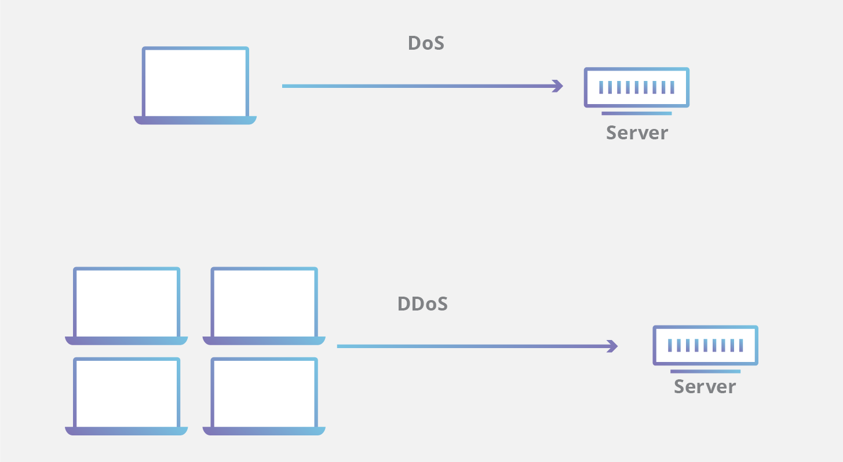

Slide 5
Types of DoS Attacks
There are three primary classes of DoS attacks:
Volume-based attacks use massive amounts of bogus traffic to overwhelm a resource such as a website or server. They include ICMP, UDP and spoofed-packet flood attacks. The size of a volume-based attack is measured in bits per second (bps).
Protocol or network-layer DDoS attacks send large numbers of packets to targeted network infrastructures and infrastructure management tools. These protocol attacks include SYN floods and Smurf DDoS, among others, and their size is measured in packets per second (PPS).
Application-layer attacks are conducted by flooding applications with maliciously crafted requests. The size of application-layer attacks is measured in requests per second (RPS).
For each type of attack, the goal is always the same: Make online resources sluggish or completely unresponsive.

Slide 6
Commonly Used DDos Attacks
UDP Flood
ICMP (Ping) Flood
SYN Flood
Slowloris
Ping of Death
NTP Amplification
HTTP Flood

